Slide 1


Slide 2
Final Project
Online Stock Management System

Slide 3
Introduction
Submitted By :
*****************
Roll # MCE IT 11-40
****************
Supervised By:
Sir Asif Raza
**************

Slide 4
Introduction Of SMS
This system is designed in favor of the stock management which helps them to save the records of the stock and other things. It helps them from the manual work from which it is very difficult to find the record of the medicines and the price list etc., and the information of about the customers and suppliers.
We design this system on the request of the Bismillah Store, through this they cannot require so efficient person to handle and calculate the things manually. This system automatically calculates all the bills and other information.

Slide 5
  Project goals and objectives
Goals:
    Elimination of paper work for appointment.
    Reduce the time and save the money.
    All orders and deliveries would be kept their record and can see any time by using their login..
    Correctness.
    Maintainability.
    users needs.

Slide 6
Project goals and objectives
    Objectives:
Online management of stock to improve and promote them is the basic objective of this project.
It will also provide an online record and catalogue of stock and information required by providing an operating online database.
Increasing the efficiency, saving time and removing human errors during recording stock data.
Providing accurate information for any medicine when required.

Slide 7
HSM Scope and Reports
Scope of the system
Providing security .
Generate receipt
Generating reports
Reports
Sales report
Customer report
Supplier Report

Slide 8
Description & Drawbacks of existing system
Description of existing system :-
The system at present working manually ,that means all the transaction going on within the system is maintain in a ledger book manually thus the management needs to transfer the system as a computerized system .

Slide 9
Description & Drawbacks of existing system
Drawbacks of existing system:-
- Difficulty in maintenance of records.
- Time consuming.
- Editing of becomes a tedious job.
- No security of data.
- Mistake occurring in long calculations.
- Not proper generation of reports.
- High data redundancy.
- Data inconsistency.
- Medicines details can not be search easily

Slide 10
Description of proposed system
Reduced manual work by generating report
Proposed system is user friendly so it is easy to operate
Save time
Ensure data security
System is helpful to see the present status of stock
Fast and accurate slip generation

Slide 11
Tool Selection
Selection of the appropriate software is most crucial stage of the development phase. The choice of software tool should be done in keeping view of the problem faced in order to avoid heavy loss of time and money. Tools used for any system development are:
1. Hardware
2. Software

Slide 12
Tool Selection
      Hardware:-
For the development and designing of website we had used better hardware for better functioning of the operating system and faster loading of programs. Hardware required to run this system will be:
    Machine Intel CORE i3
    Processor Intel(R) Core(TM) i3-2370M CPU @ 2.40GHz
    RAM 2 GB

Slide 13
Tool Selection
    Software:-
Any hardware without software is seemed to be useless in this environment. So different types of software are considered for this specific purpose. Chosen ones are:
Operating System Windows 7/Windows 8
Front end tool HTML, CSS
Back end tool PHP , Java script
Graphic Designing tool Dreamweaver CS6
Database MS SQL
Tools for documentation MS Word

Slide 14
Tools Used for development
Tools and Using Reasons :-
PHP
For making interface and coding.
My SQL
To keep the record of users and their details also for maintaining User personal data for booking request.
MS Word
For ERD diagram, For Use Case diagram ,System Sequence diagram, Sequence diagram.

Slide 15
Tools Used for development
Tools and Using Reasons :-
CSS
For Style.
Java Script
For handle events and form validation.
Dreamweaver CS6
For making interfaces /front –end and admin panel.
HTML
For front end page management.

Slide 16
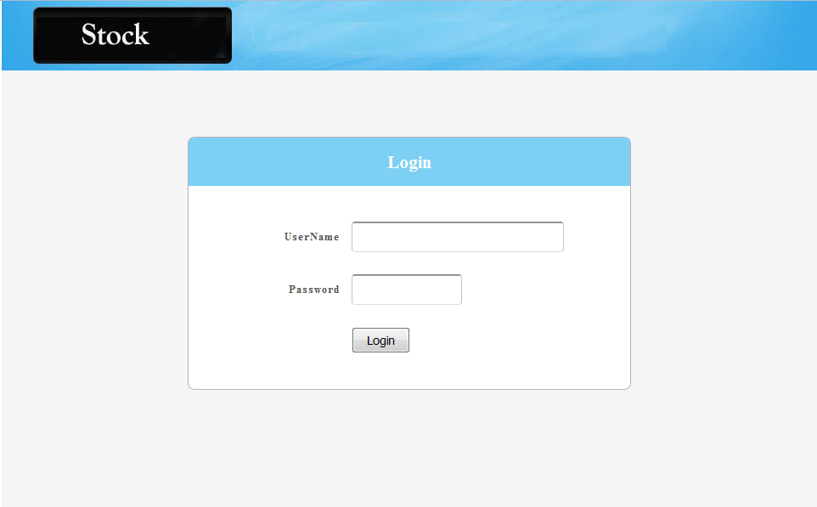
Admin Log In Interface

Slide 17
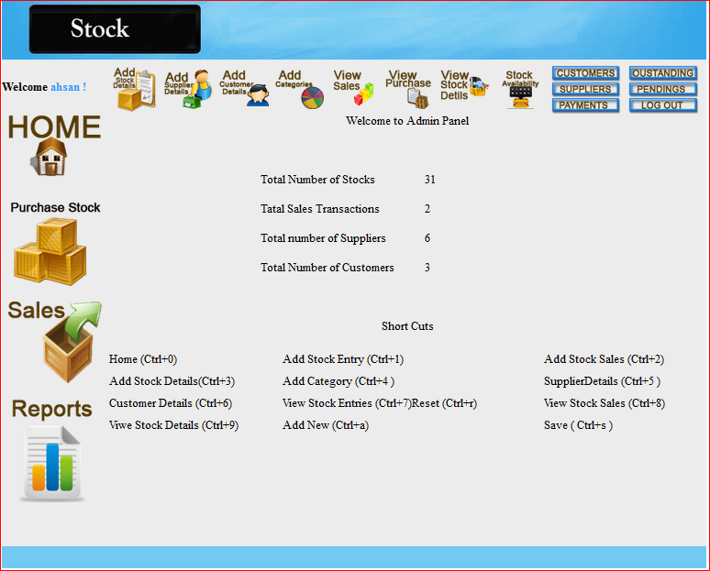
User Interface

Slide 18

User Data Base

Slide 19
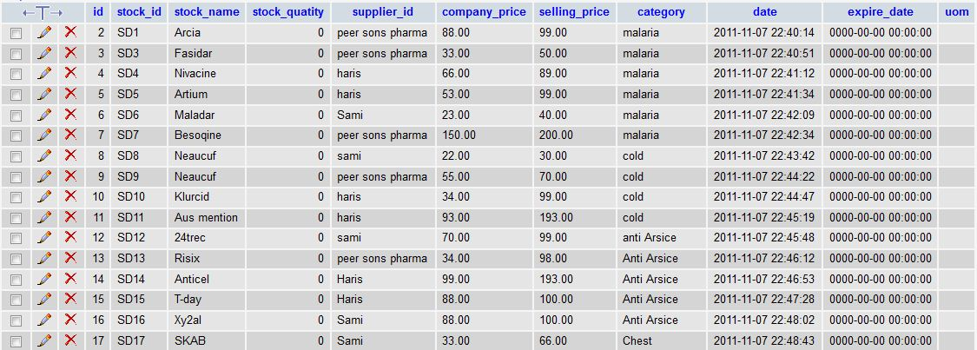
Stock Data Base

Slide 20


